Slide 1
Effect of Surface Treatments on the Superconducting Properties of Niobium
Presented by A.S.Dhavale
Sept. 23, 2010

Slide 2
Measurements
Thermal Conductivity Measurement
DC magnetization Measurement
AC measurement
Pinning Measurement/ Penetration Depth Measurement
Transition Temperature Measurement

Slide 3
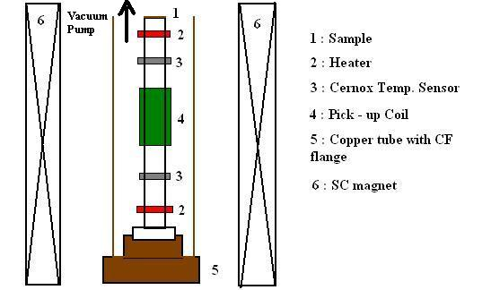
Measurement Set-up
Samples:
LG : Ingot A,B,C,D
(From CBMM, Brazil)
FG : RRR ~ 300 (From Wah Chang)
Cylindrical Shape
Outer Diameter :6mm
Inner Diameter :2 mm
Length :120 mm
Sample Treatment :
Baseline measurement : BCP + Bake (160 C, 12 hr)
EP (~ 50 μm)
EP + Bake (120 C, 48 hr)

Slide 4
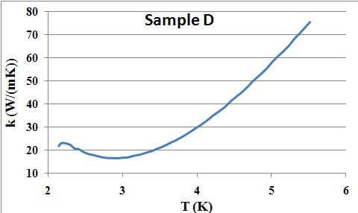
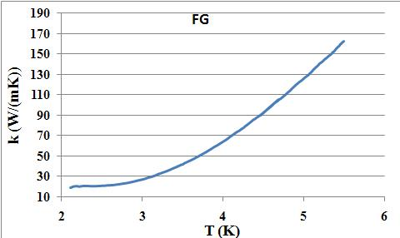
Thermal Conductivity Measurement
P - Set Heater Power
d - Distance between temp. sensors
A - Cross-sectional area
ΔT – Temp. difference
RRR ~ 4 * k
at 4.2 K
RRR = 148
k = 24 W/mK
(at 2 K)
RRR = 300
k = 16 W/mK
(at 2 K)

Slide 5
DC Magnetization Measurement
Samples Zero Field Cooled (ZFC) to 2 K
Full Magnetization Measurement (-H to H)
Measurement of Magnetization with different surface treatments
Magnetization Measurement at different Temperatures from 2 K to 8 K
∗ Samples ZFC before every measurement
∗ Sample Temperature : (Tset ± 0.2) K

Slide 6
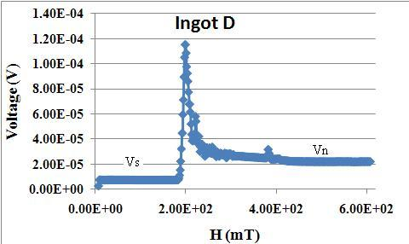
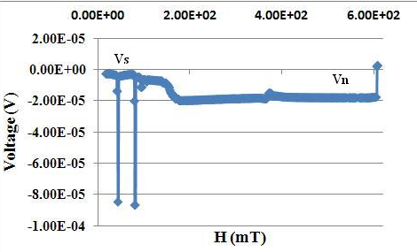
Results
Recorded Voltage during ramp up
Recorded Voltage during ramp down
Nd = 0.007

Slide 7
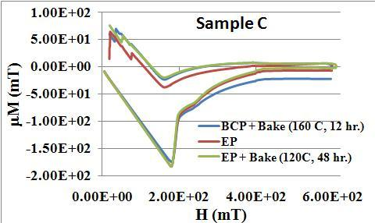
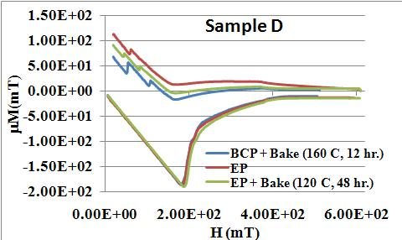
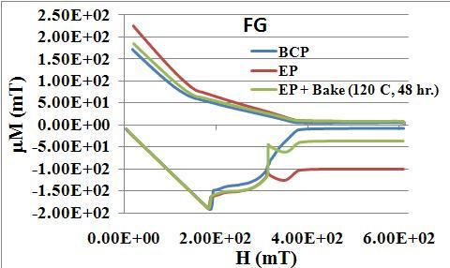
Magnetization with Various Surface Treatments
Magnetization curve is altered with different
surface treatments
No appreciable change in Hc1, Hc2
“Peak Effect” observed only in FG : EP,
FG : EP +Bake sample at T = 2 K
This can be attributed to the change in the
compressional modulus of FLL

Slide 8
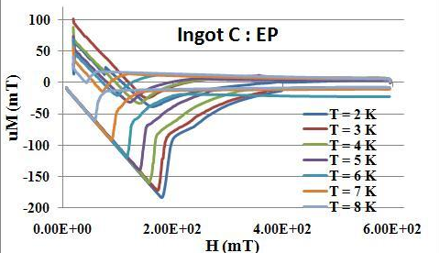
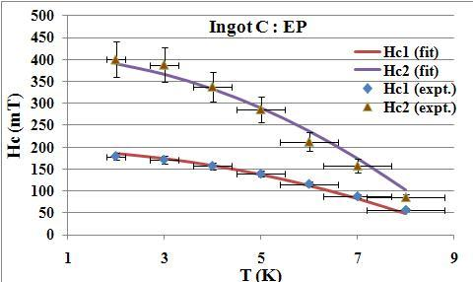
Magnetization at Various Temperatures
T (K) | Hc1 (mT) | Hc2 (mT)
2 | 179 | 400
3 | 171 | 388
4 | 157 | 338
5 | 139 | 286
6 | 116 | 212
7 | 88 | 157
8 | 57 | 85
Fitting Equation for Hc1, Hc2
Fitted Parameters : Hc1(0) = 193.77 mT
Hc2(0) = 410.54 mT
Tc = 9.245 K

Slide 9
Fitted Parameters at 0 K
Sample | EP |  |  |  | EP + Bake (120 C, 48 hr.)
 | Hc1(0) | Hc2(0) | Tc(fit) | Tc (expt) | Hc1(0) | Hc2(0) | Tc(fit) | Tc (expt)
A | 187.45 | 405.18 | 9.245 | 9.217 | 189.81 | 416.63 | 9.245 | 9.218
B | 184.25 | 383.03 | 9.09 | 9.251 | 199.05 | 420.38 | 9.258 | 9.258
C | 193.77 | 410.54 | 9.245 | 9.247 | 194.27 | 417.93 | 9.245 | 9.24
D | 189.63 | 431.75 | 9.13 | 9.245 | 192.42 | 421.4 | 9.248 | 9.244
FG | 195.52 | 430.61 | 9.366 | 9.259 | 197.55 | 400.6 | 9.237 | 9.27

Slide 10
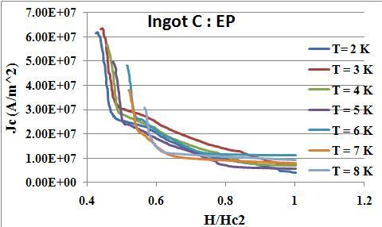
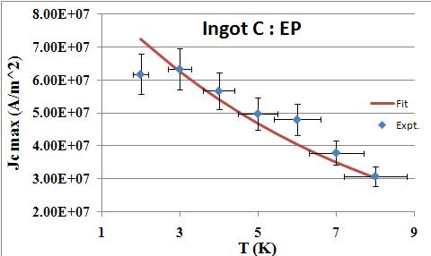
Calculation of Critical Current Density, Jc
Calculated from the width of
Magnetization loop
Maximum Jc falls exponentially with
Temperature
Empirical fitting Equation
Jc(T) = Jc(0) Exp(-T/T0)
T0 = 6.85 K
Sample | Jc(0) A/m^2
 | EP | EP + Bake
A | 8.14 x 10⁷ | 9.3 x 10⁷
B | 9.24 x 10⁷ | 1.0 x 10⁸
C | 9.7 x 10⁷ | 9.7 x 10⁷
D | 1.1 x 10⁸ | 1.0 x 10⁸
FG | 1.38 x 10⁸ | 1.37 x 10⁸

Slide 11
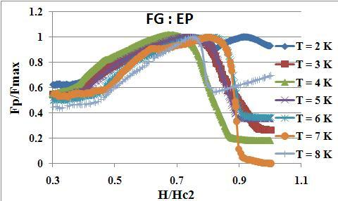
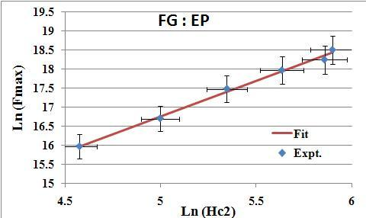
Calculation of Pinning Force, Fp
Pinning of Vortices at Defects
Fp = FL ; vortices stationary
FL > Fp ; depinning
Lorentz Force = FL = Jc x B
Normalized Fp Vs reduced magnetic
field, b(=H/Hc2) trace same curve at
all the temperatures
Pinning Model by W. A. Fietz and W. W. Webb,
FG : m =1.87, p = 2 , q = 1;
Max. Fp at b = 0.7
LG : m =1 to 1.75 ;
Max. Fp at b = 0.6

Slide 12
Absolute value of Fp and Jc at 2 K for various samples
Sample | RRR (Chemical Analysis) | RRR (Thermal Conducti-vity) | Jc (A/m^2) | Fp (N/m^3)
A | 97 ± 10 | 97 | 3.51 x 10⁷ | 5.8 x 10⁷
B | 150 ± 27 | 229 | 5.21 x 10⁷ | 7.41 x 10⁷
C | 114 ± 15 | 182 | 4.19 x 10⁷ | 6.18 x 10⁷
D | 145 ± 25 | 148 | 7.21 x 10⁷ | 8.04 x 10⁷
FG | >250 | 300 | 1.1 x 10⁸ | 1.03 x 10⁸
* Pinning Force is higher in FG than LG
* FLL is more rigid in case of pure material, so higher is the pinning force

Slide 13
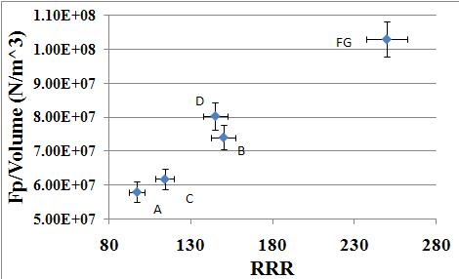
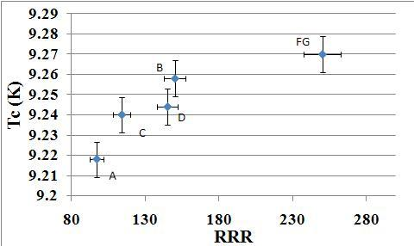
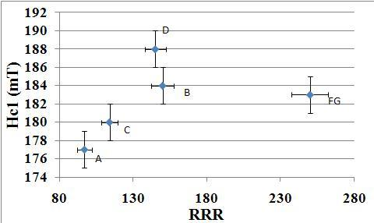
Variation of Bulk Properties with RRR

Slide 14
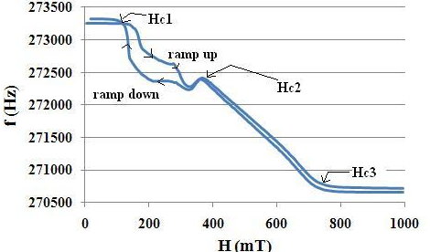
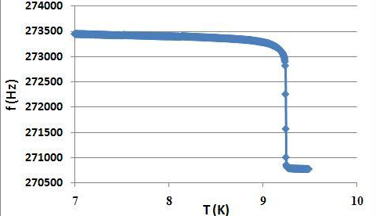
AC Measurement
AC magnetic Field superimposed parallel to the DC magnetic field
Pick – up coil is a part of LC oscillator (Frequency ~ 0.27 MHz),
C = 30nF (fixed)
Change in the oscillator frequency is recorded as a function of DC field
Change in frequency is a measure of change in the penetration depth
Pinning Measurement
Hysteresis between Hc1 and Hc2 due
to pinning
Measurement of Transition Temp., Tc
Zero Magnetic field
Frequency change is due to change penetration depth with temperature

Slide 15
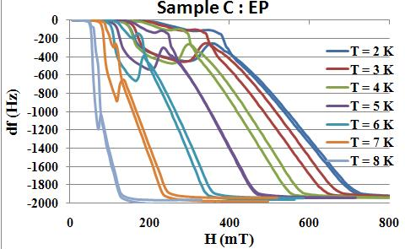
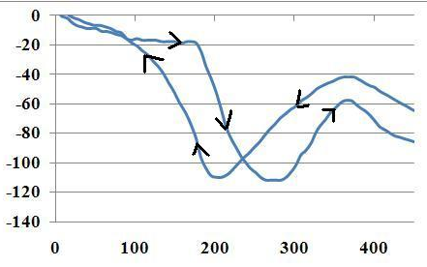
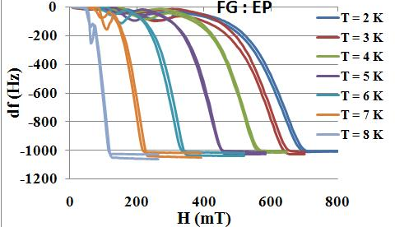
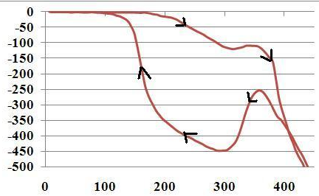
Change of Frequency/ Penetration depth with Temperature and Magnetic Field

Slide 16
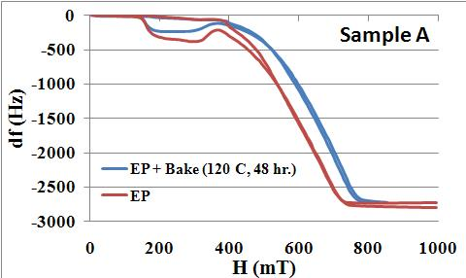
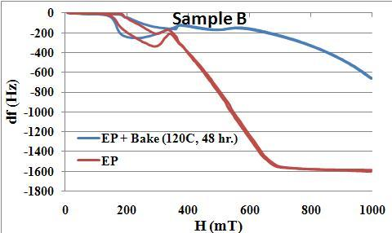
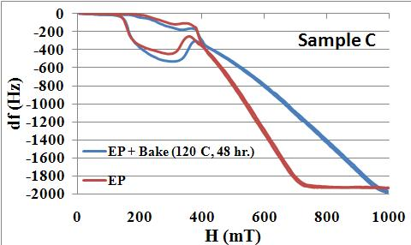
Change of frequency with Surface Treatment at T = 2 K

Slide 17
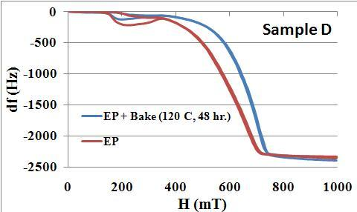
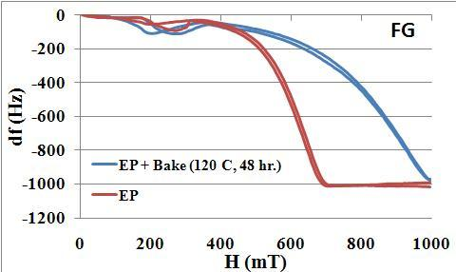
In all the samples, LTB improved the HC3

Slide 18
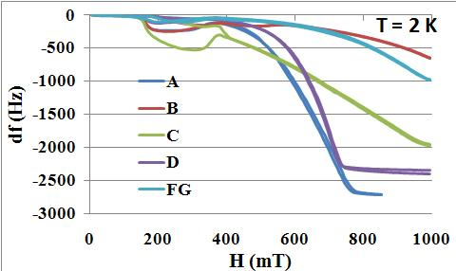
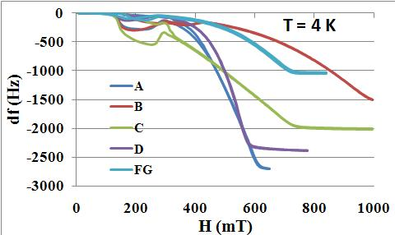
Change of frequency for various samples at T =2 K, 4 K after 120 C, 48 hr. baking
* Hc3 of sample B is highest; Hc3 = 1 T at 4 K
* Penetration depth related to RRR
* RRR in increasing order A, D, C, B and FG

Slide 19
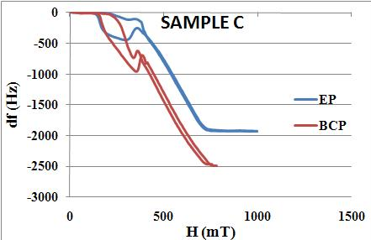
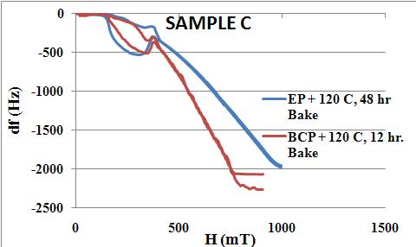
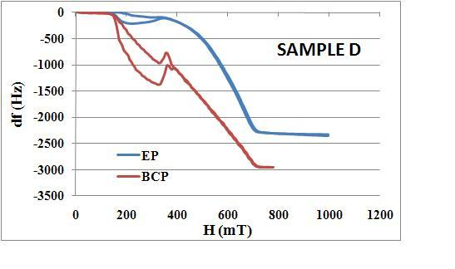
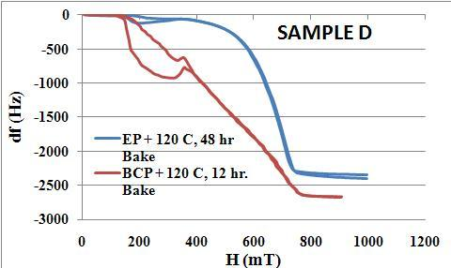
Comparison of Data for BCP-EP and Bake at 120 C at 2 K

Slide 20
Comparison of Hc1 obtained after BCP – EP and 120 C, Bake
Ingot | RRR | BCP |  |  | EP
 |  | Hc1_dc | Hc1_ac | Hc1_ac,bake | Hc1_dc | Hc1_ac | Hc1_ac,bake
A | 97 | 172 | 100 | 129 | 177 | 162 | 170
C | 114 | 175 | 115 | 130 | 180 | 160 | 168
D | 145 | 176 | 104 | 131 | 188 | 164 | 166
B | 150 | 181 | 120 | 130 | 184 | 175 | 180

Slide 21
Surface critical fields at 2 K
 | EP |  |  |  | EP + bake(120C, 48hr.)
 | Hc1 | Hc2 | Hcoh | Hc3 | Hc1 | Hc2 | Hcoh | Hc3
A | 162 | 322 | 669 | 749 | 170 | 351 | 739 | 850
B | 175 | 317 | 627 | 705 | 180 | 381 | 1 T | >1 T
C | 160 | 331 | 653 | 753 | 168 | 351 | 908 | 1 T
D | 160 | 330 | 680 | 740 | 166 | 347 | 698 | 750
FG | 164 | 301 | 652 | 700 | 170 | 320 | 932 | >1 T
∗ Sawilski et. Al. showed the existence of coherent phase of surface superconductivity between Hc2 and Hc3
Ratio, Hcoh/ Hc3 ~ 0.8
This is confirmed by S. Casalbouni
In our case, ratio Hcoh/ Hc3 ~ 0.8 to 0.9

Slide 22
Ratio Hc3/Hc2 and Hcoh/Hc2 at T = 2 K
Sample | EP |  | EP + Bake
 | Hcoh/Hc3 | Hc3/Hc2 | Hcoh/Hc3 | Hc3/Hc2
A | 0.89 | 2.32 | 0.87 | 2.42
B | 0.89 | 2.22 | < 1.0 | > 2.62
C | 0.87 | 2.27 | 0.9 | 2.85
D | 0.9 | 2.31 | 0.93 | 2.24
FG | 0.93 | 2.32 | 0.93 | > 3.1
Ratio Hcoh/Hc3 and Hc3/Hc2 at T =4 K after EP + Bake
Sample | Hcoh/Hc3 | Hc3/Hc2
A | 0.9 | 2.34
B | 0.95 | 2.5
C | 0.87 | 2.83
D | 0.92 | 1.98
FG | 0.93 | 2.95

Slide 23
Conclusion
Due to large sample size, measured bulk properties are average and hence not sensitive to surface treatments
Fp ∝ Hc2(T), m = 1.87 for FG; m ~ 1 – 1.75 for LG and Fp ∝ 1/grain size
Reduction in penetration depth is considerable in all the samples treated with EP compared to BCP
Effect of baking is to improve the ratio, Hcoh/Hc2 and hence the ratio, Hc3/Hc2

Slide 24
Acknowledgement
Dr. G. Myneni
Dr. G. Ciovati
M. Morrone
P. Kushnick

